Slide 1
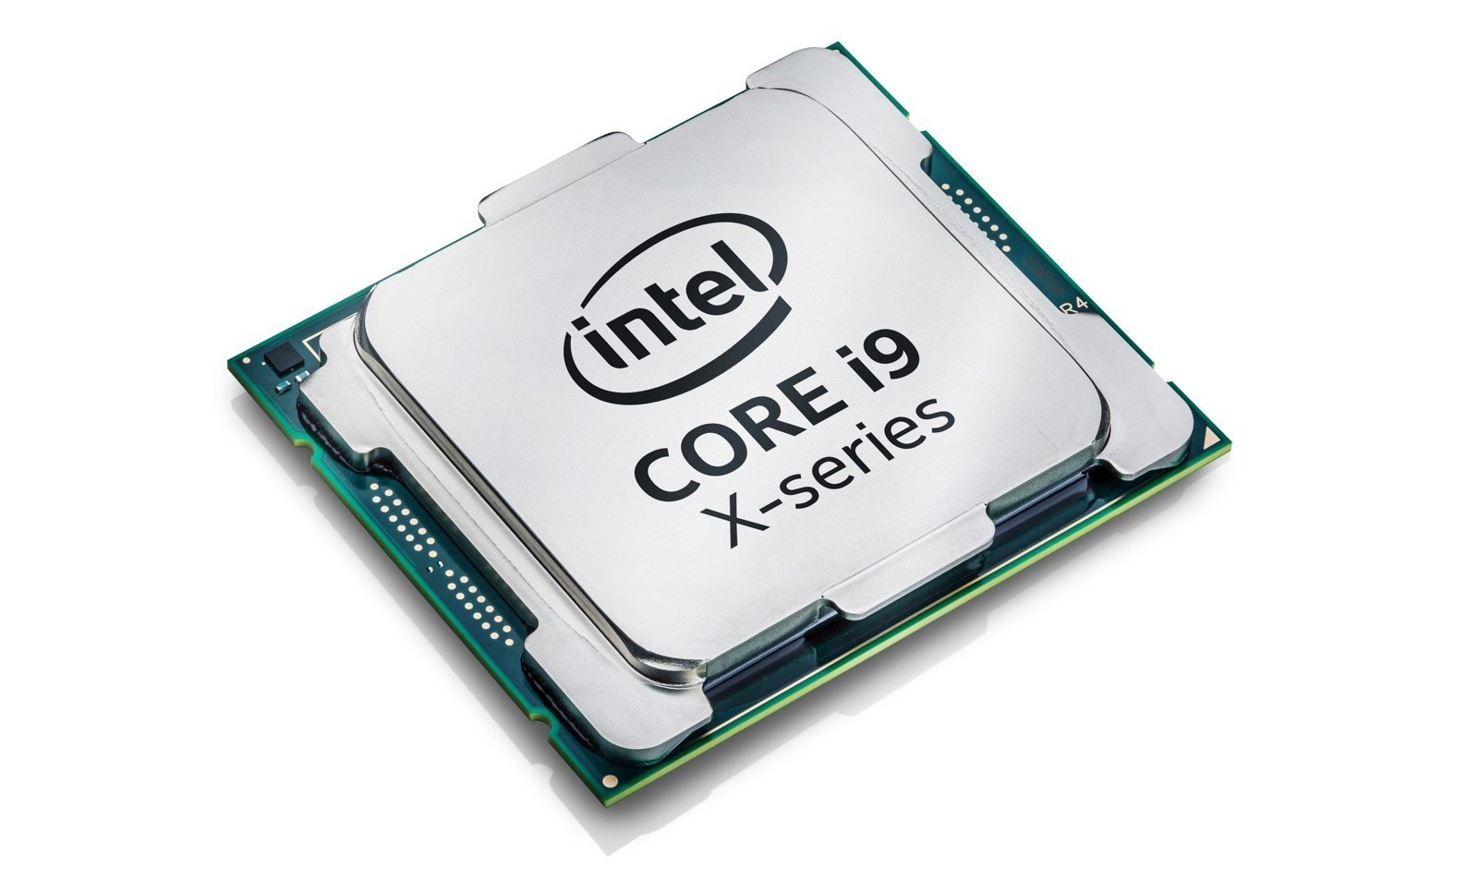
Cse-341 Team Mosfet
Md Asif Talukdar (ID: 17101305)
Syed Mahbubuz Zaman (ID: 16201017)
Quazi Fahmiduzzaman (ID: 17101307)
Wasiu Abtahee (ID: 17304141)
Mamur Taharat (ID: 17101282)

Slide 2
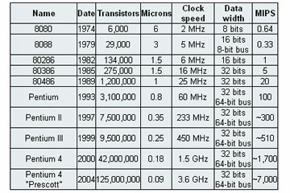
Background :
Pioneer in microprocessor technologies.
Repeatedly dominates the market.
Performance in single core is still unbeatable.

Slide 3
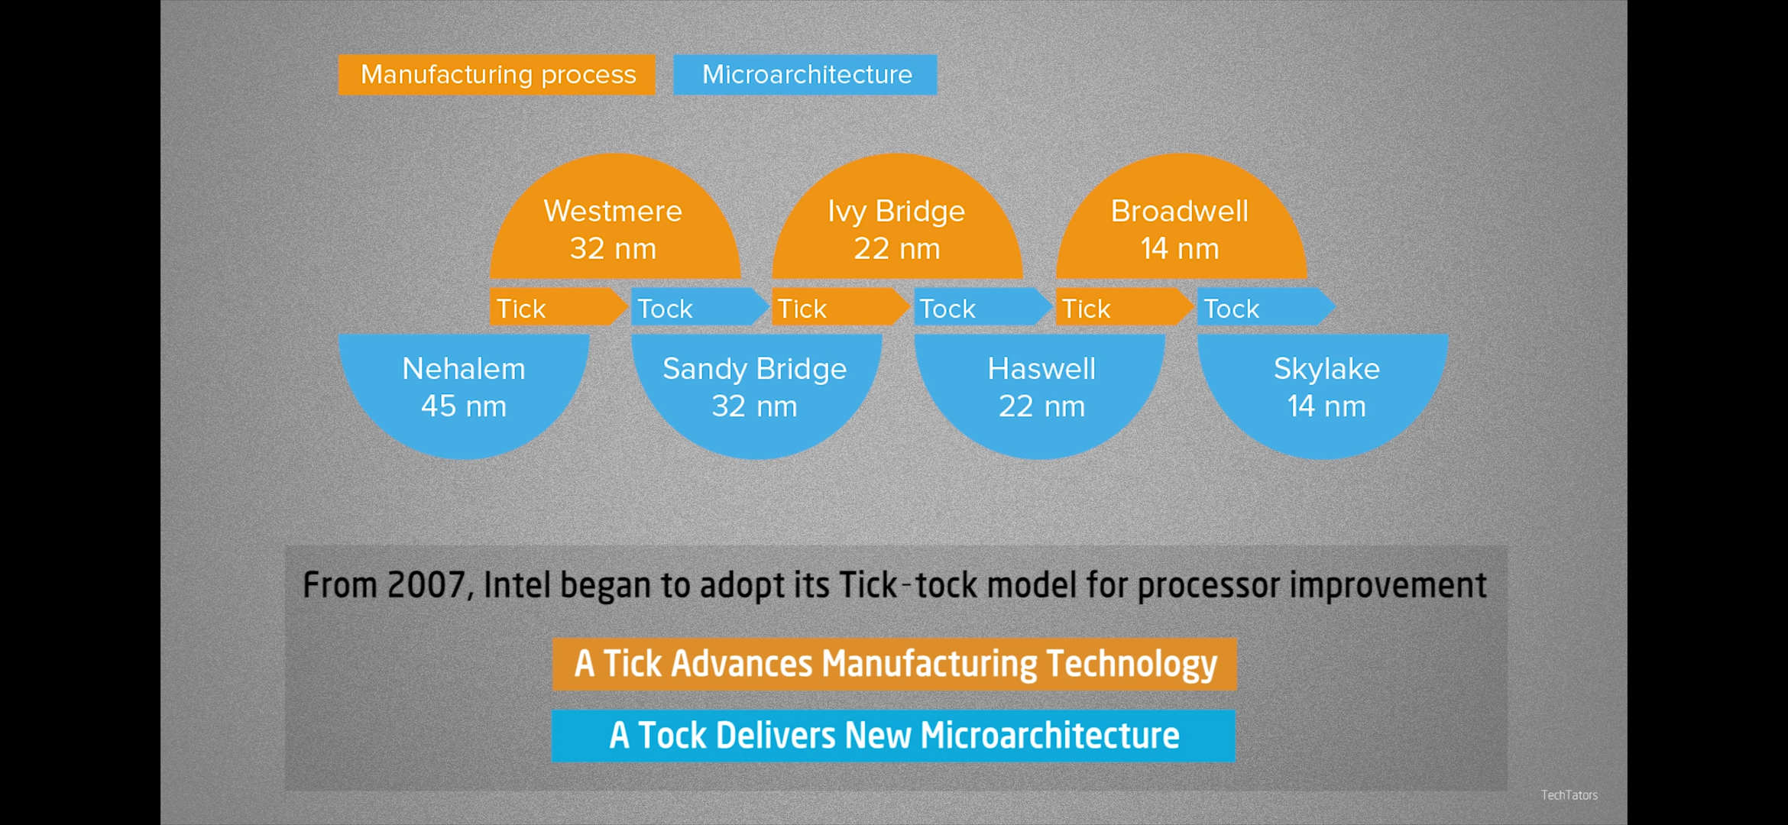

Slide 4
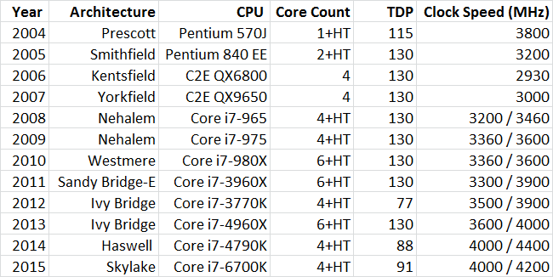

Slide 5
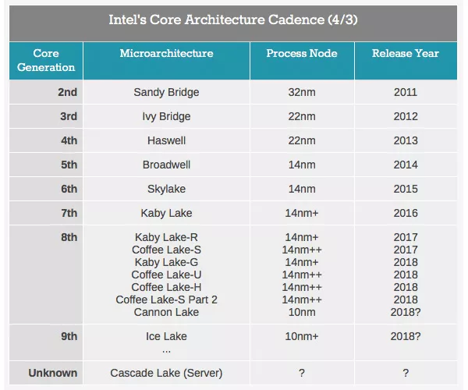

Slide 6
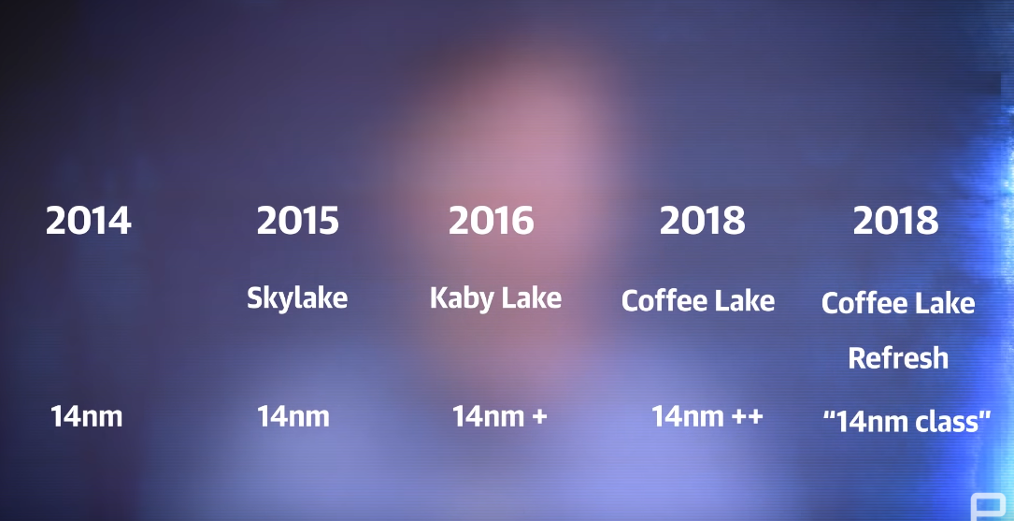
Continuation of series :

Slide 7
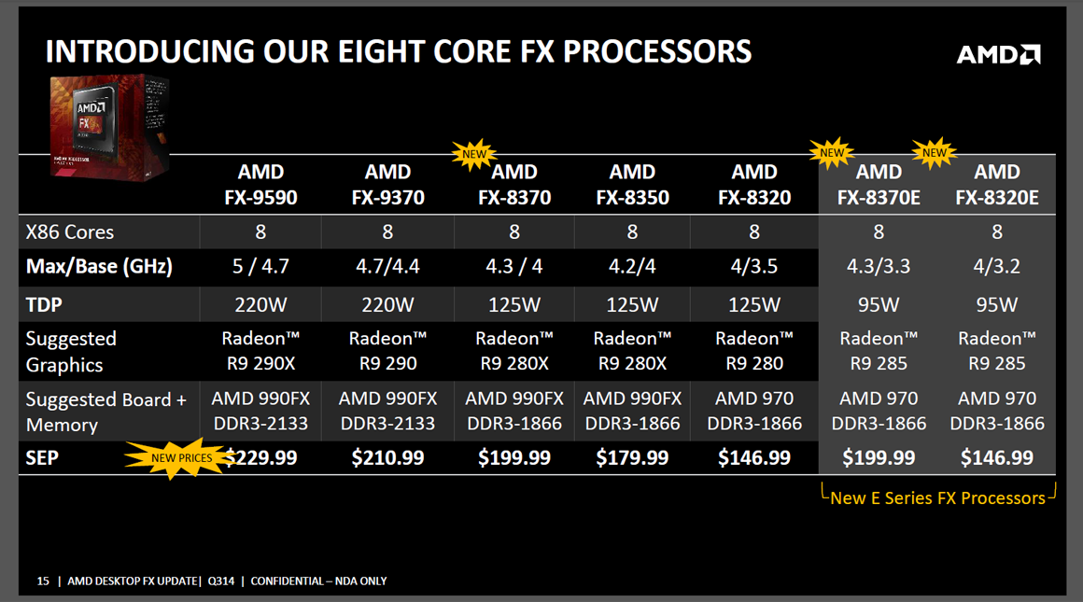
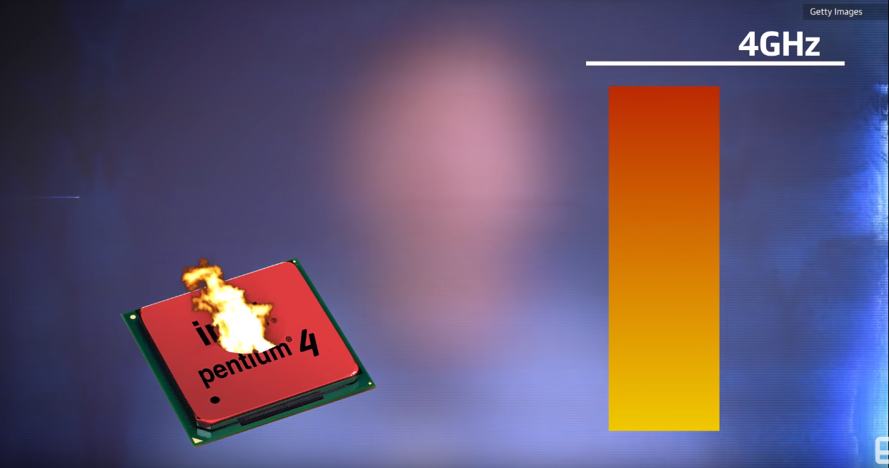

Slide 8
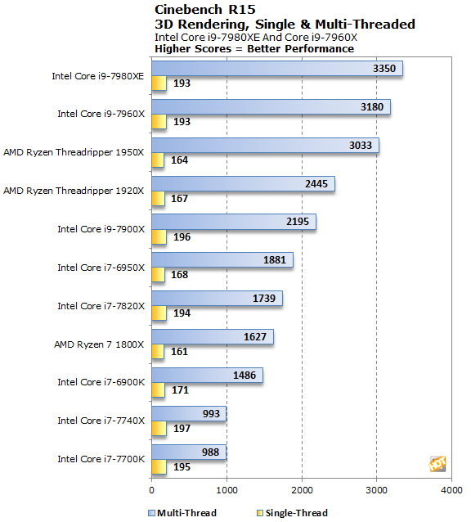
Performance :

Slide 9
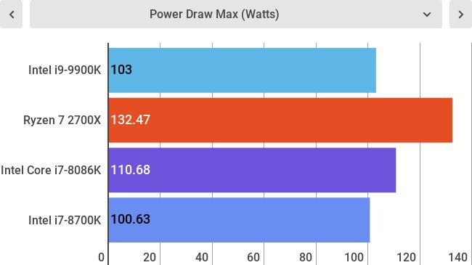
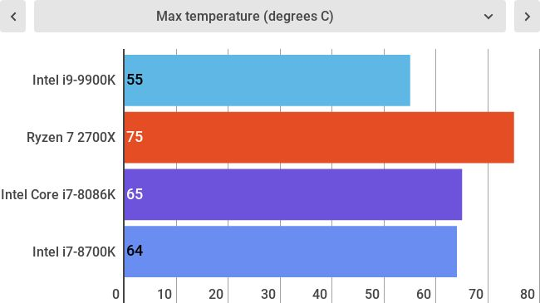

Slide 10
Intel® Turbo Boost Max Technology 3.0 :
Intel® Turbo Boost Max Technology 3.0 identifies the best performing core(s) on a processor
Provides increased performance on those cores through increasing frequency as needed by taking advantage of power and thermal headroom.
The Core i9-9900K has a TDP rating of 95 watts. They state an all-core base frequency of at least 3.6 GHz and this is what the TDP is measured from. However, they also state that if just a single core is active, it will operate at 5 GHz.

Slide 11
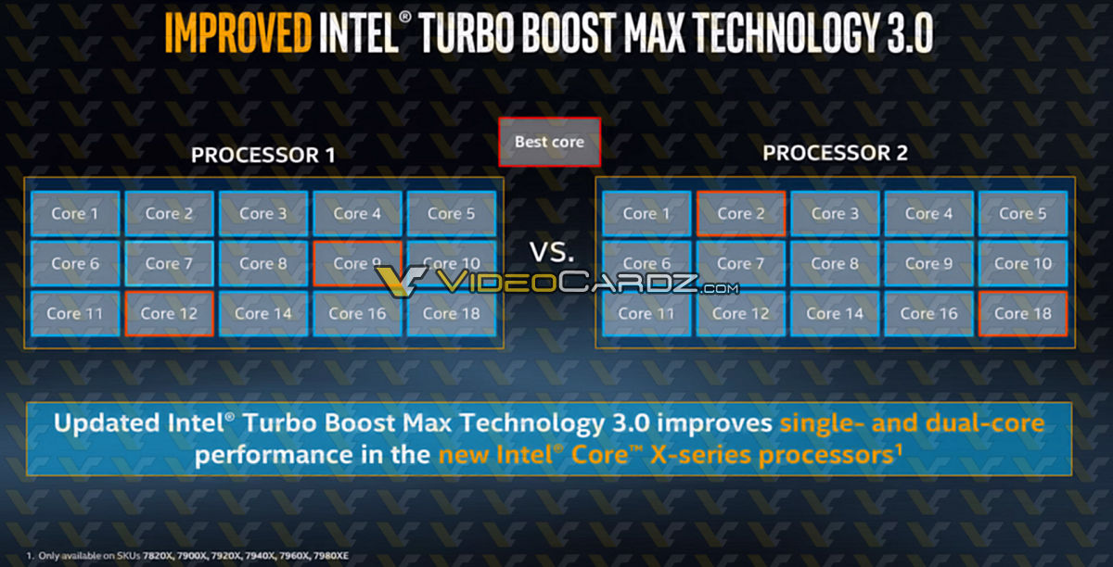

Slide 12
Our Verdict :
The Intel Core i9-9900K retakes the multi-core lead from AMD with record setting processing power. However, those looking for the ultimate gaming processor should look elsewhere.
FOR
Dominating hyper-threading performance
Runs significantly cooler
Tight energy consumption
AGAINST
Expensive
Little to no improvement for gaming

Slide 13
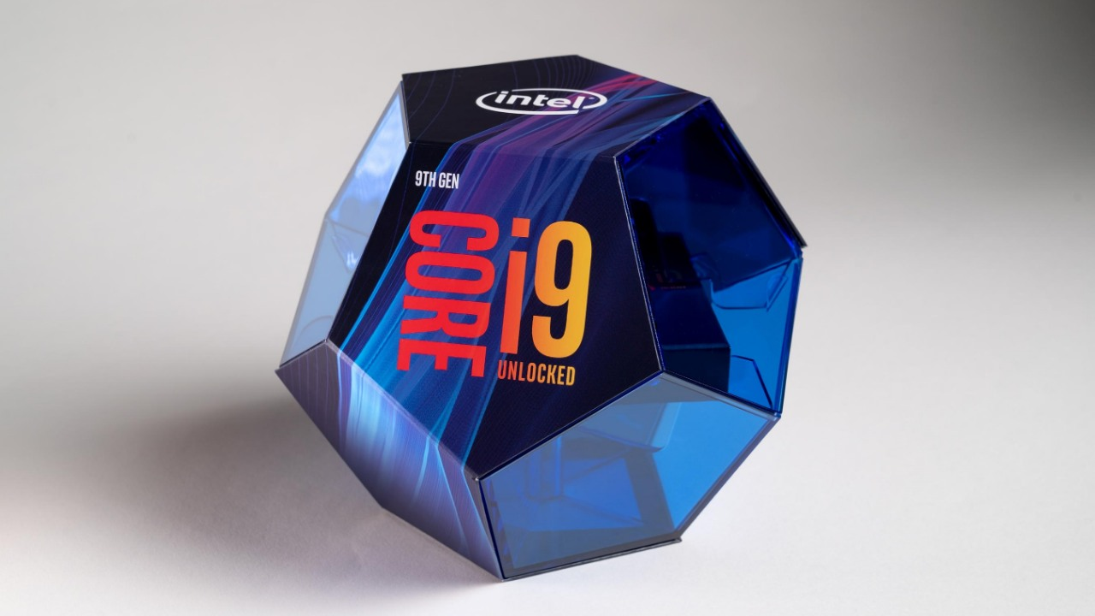
Thank you.

